Slide 1
Weed Detection System Using Faster R-CNN
Batch No:A16
Guided by:
Y. Mastanih Naidu
Team Members:
CH. Lakshmipriya (Y20AIT418)
D. Sasikala (Y20AIT425)
M. Himavanth (L21AIT411)
D. Srujana (Y20AIT428)

Slide 2
Abstract
In agricultural regions, the procedure of weed removal is crucial. Weed removal in the classic way, takes longer and requires greater physical effort. The idea is to eliminate weeds from agricultural fields automatically. The proposed study uses a deep learning algorithm to detect weeds growing between crops. Deep learning method is used to analyze the main properties of agricultural photographs. Weeds and crops have been identified using the dataset. Convolutional neural network (CNN) extracts features of crop and weed using deep learning, and the features are used to identify the weed.

Slide 3
Dataset
Reference :
https://www.kaggle.com/datasets/ravirajsinh45/crop-and-weed-detection-data-with-bounding-boxes.
Analysis on dataset:
This dataset contains 1300 images of crops and different types of weeds with each image labels.[626-crop, 674-weed]
The photo size is 4000X3000 color which is very large and model will take very long time for training so we convert all images to 512X512 size.

Slide 4
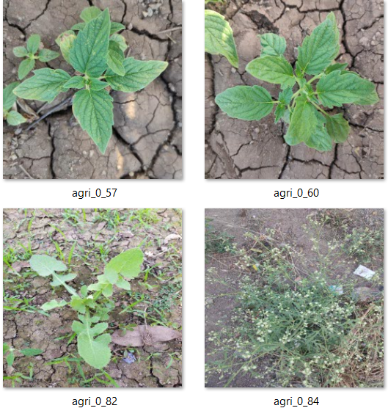
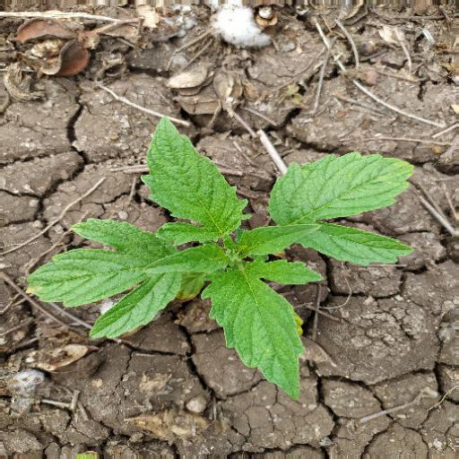
Sample Images

Slide 5
Literature Survey
2.Title: Weed Plant Detection using YOLOv3 Algorithm [2022].
Methods: Discuss about YOLO Algorithm for classifying the weed photos from the alternative crops.
1.Title: Deep Learning techniques for in-crop weed recognition [2023]
Methods: Discusses various methods, including pre-processing, feature extraction, and classification on weed images.
Disadvantage: Classification accuracy depends on proper images and image resolution.
Disadvantage : Can struggle detect the smaller objects.

Slide 6
Proposed System
Faster R-CNN short for “Faster Region-Convolutional Neural Network” is a state-of-the-art object detection architecture of the R-CNN family, introduced in 2015. The primary goal of the Faster R-CNN network is to develop a unified architecture that not only detects objects within an image but also locates the objects precisely in the image. It combines the benefits of convolutional neural networks (CNNs), and region proposal networks(RPNs).Which significantly improves the speed and accuracy of the model.

Slide 7
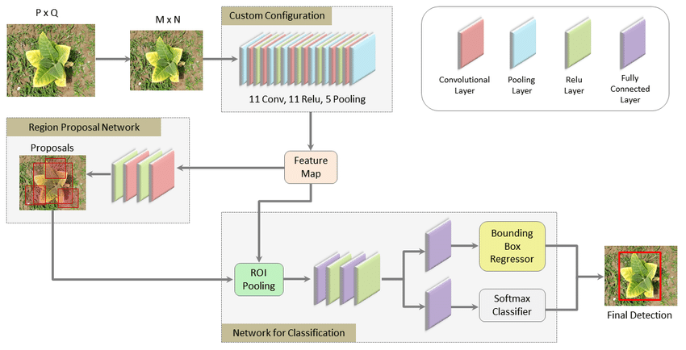
Proposed System architecture

Slide 8
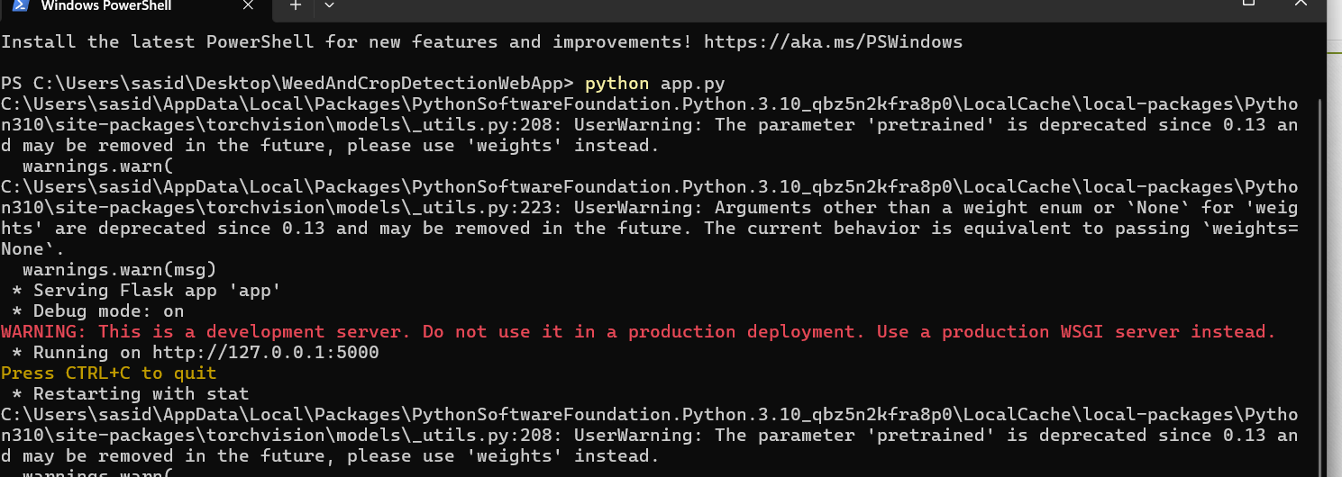
System Implementation

Slide 9
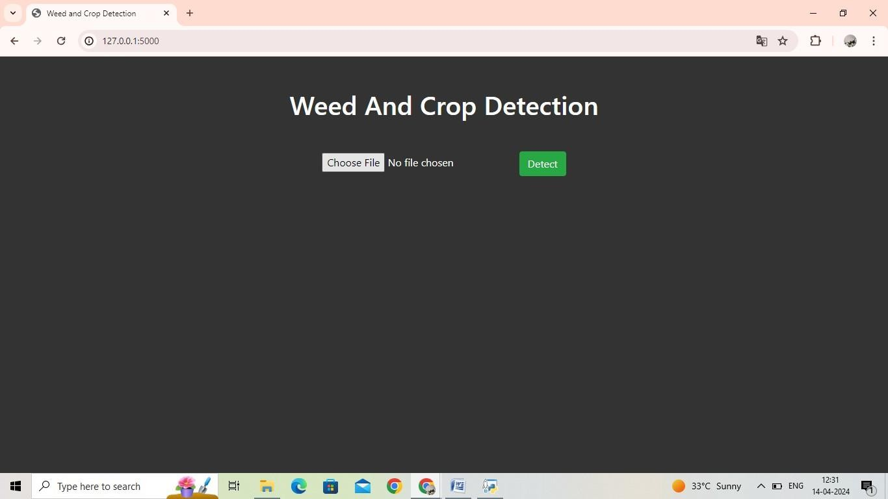
User Interfaces

Slide 10
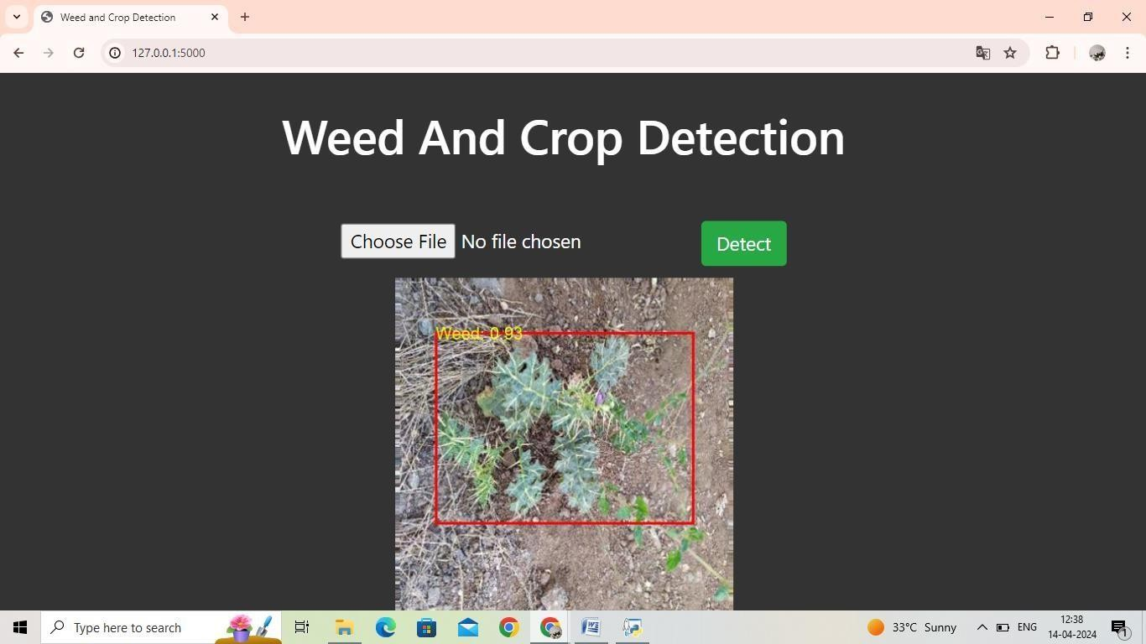
After detection

Slide 11
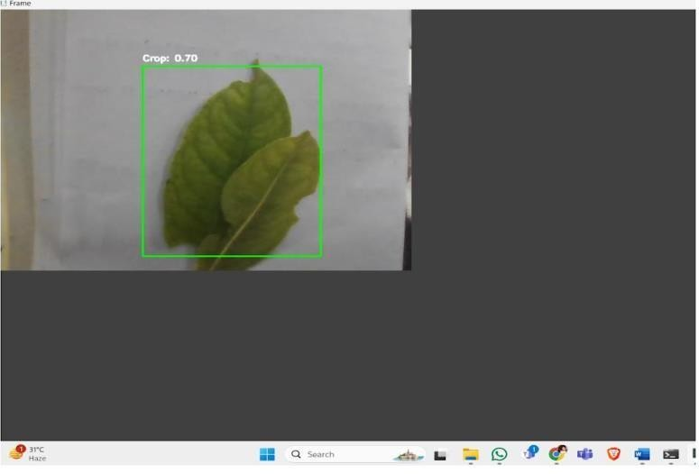

Slide 12
System Requirements
Model Trained on: Google Colab
Software Requirements: Windows 7 or Higher, Python and it’s related packages(PyQT6, PyTorch … etc)
Hardware Requirements: Minimum 4gb Ram, 200 Mb storage space required.

Slide 13
Conclusion
Seeing insights from two seminal papers on weed detection through image processing and deep learning, our implementation of the Faster R-CNN model has culminated in an effective method for differentiating weeds from crops, enhancing the precision of agricultural practices.

Slide 14
References
[1] Vijaykumar Bidve1, Sulakshana Mane2, Pradip Tamkhade3, Ganesh Pakle Weed detection by using image processing 4 Indonesian Journal of Electrical Engineering and Computer Science Vol. 30, No. 1, April 2023, pp. 341~349 ISSN: 2502-4752, DOI: 10.11591/ijeecs.v30.i1.pp341-349
[2] Kun Hua,∗, Zhiyong Wanga, Guy Colemanb, Asher Benderc, Tingting Yaod, Shan Zenge, Dezhen Songf, Arnold Schumanng, Michael Walshb Deep Learning Techniques for In-Crop Weed Identification: A Review
[3] Shaoqing Ren, Kaiming He, Ross Girshick, Jian Sun Faster R-CNN: Towards Real-Time Object Detection with Region Proposal Networks
[4] https://pytorch.org/vision/main/models/faster_rcnn.html

Slide 15
Thank you

